Slide 1

DFA VISUALIZER
Muhammad waqi (23-cs-59)
Ahmed zaman (23-cs-55)

Slide 2
DFA Visualizer provide a clear, interactive way to understand deterministic finite automata. It helps users visualize states, transitions, and the acceptance or rejection of input strings, making it easier to learn, debug, and explore DFA behavior effectively.
- GOAL

Slide 3
PROBLEM STATEMENT
Understanding and designing deterministic finite automata (DFA) can be challenging due to their abstract nature and lack of visual feedback. Students and developers often struggle to visualize state transitions and debug DFA behavior when processing input strings. There is a need for an interactive tool that allows users to create and analyze DFAs in a visual and intuitive manner, helping bridge the gap between theoretical concepts and practical understanding.

Slide 4




TOOLS USED
Software/Code Editor Used:
1) VS Code
Language Used:
1) HTML 2) CSS 3) JavaScript
Libraries Used:
1) React 2) JointJS

Slide 5
OBJECTIVES
To promote active learning by allowing students to construct and test their own DFA examples interactively.
To enhance conceptual understanding of DFA components such as states, transitions, start and accepting states.
To validate input strings against the defined DFA and indicate whether they are accepted or rejected.

Slide 6
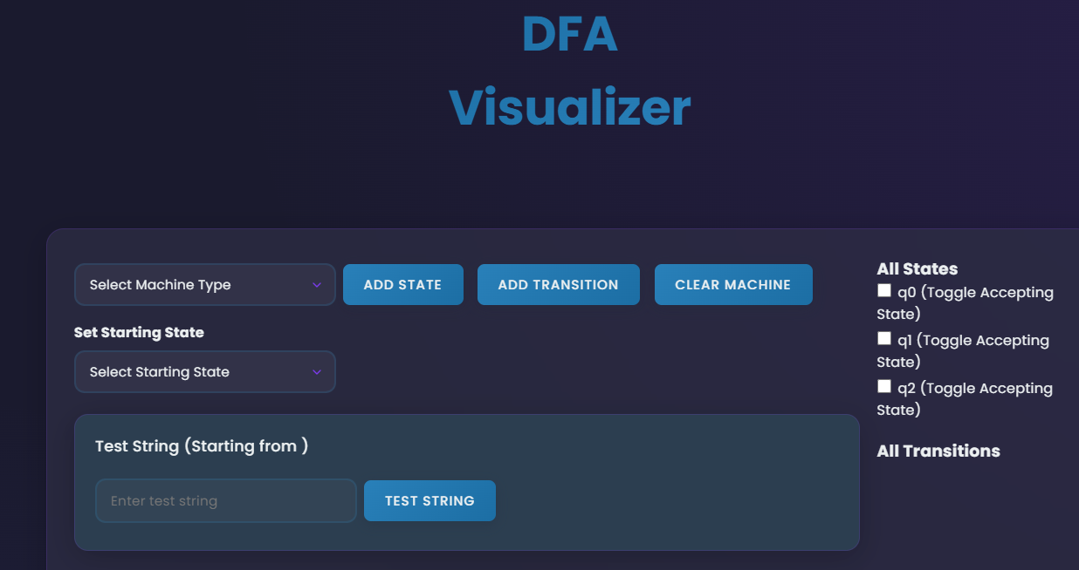
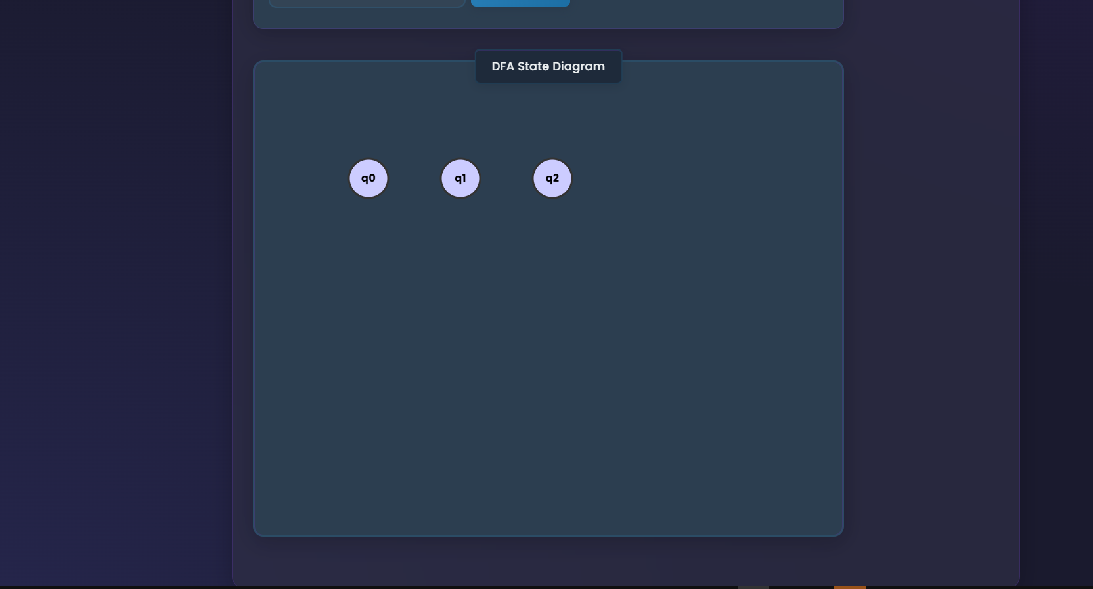
PROJECT DEMO

Slide 7
FUTURE GOALS
We plan to extend the tool to support NFA (Nondeterministic Finite Automata) simulation, helping users explore more complex automata concepts. Additionally, features to load and save machines will be added, making it easier to reuse and share automata for learning and collaboration.

Slide 8
THANK YOU
Hope you like our presentation!

